Slide 1

TITLE PAGE
Problem Statement ID: ED004
Problem Statement Title : Smart Assessment & Anti-Cheating System
Domain : EdTech
Team Name : Dolce far niente
Team Leader Name : Shivraj Iranna Talwar

Slide 2
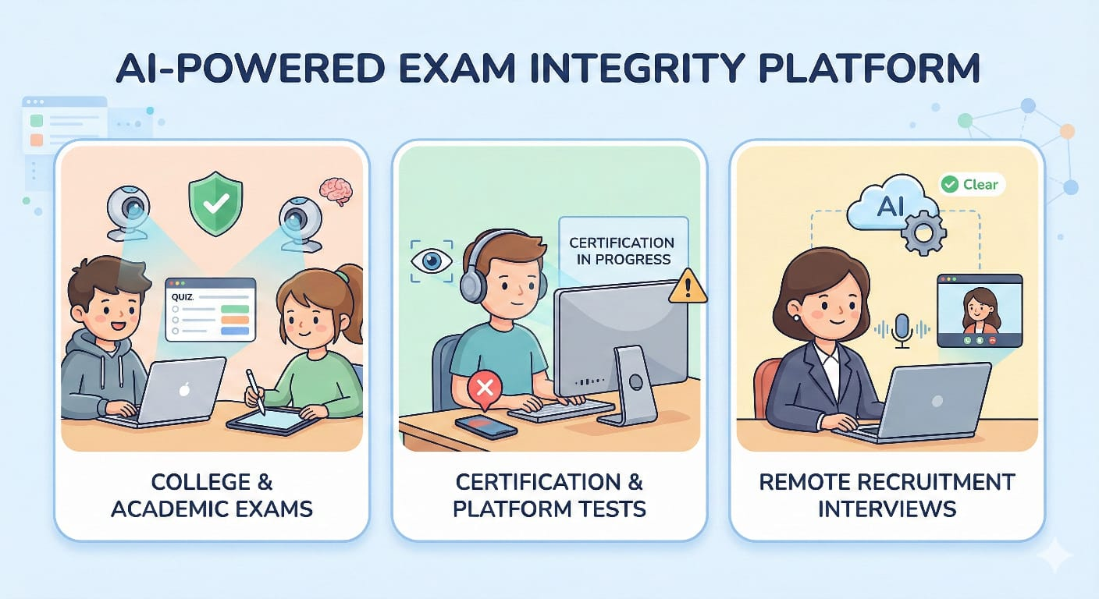
Idea/Approach Details
PROPOSED SOLUTION :
Growth of online platforms has increased cheating and impersonation issues.
Existing systems rely on basic webcam monitoring and manual invigilation.
Proposed AI-based system ensures secure and fair online examinations.
Uses video, audio, behavioral, and system-level monitoring
Integrates identity verification, continuous proctoring.
The system is Accurate, Scalable, cost-effective, and works with standard webcams and microphones.
It can be effectively used for online Examinations, Interviews, Assessments, and Secure virtual sessions.

Slide 3
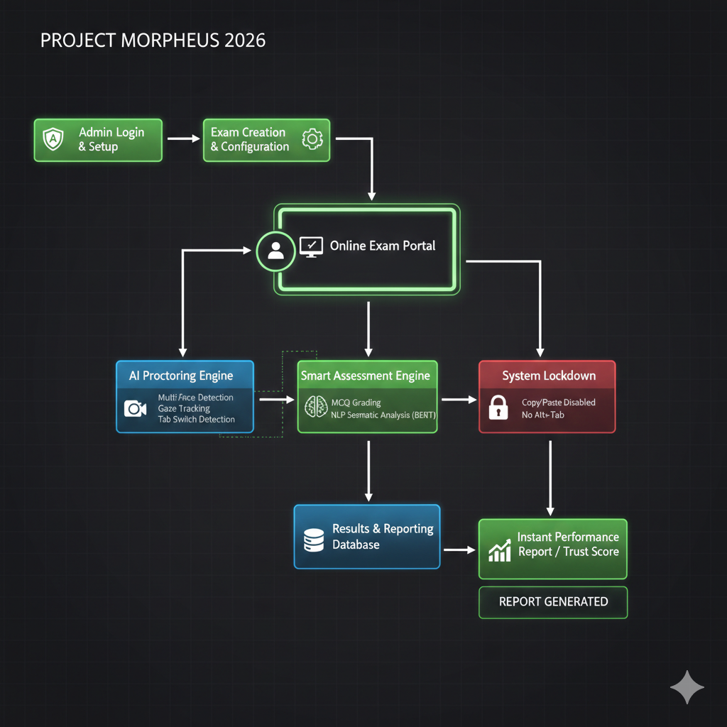
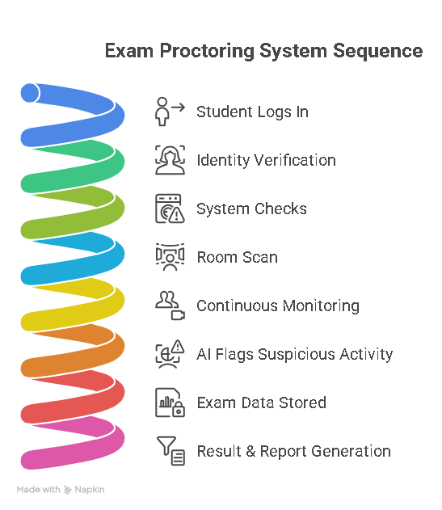
Process flow diagram
Flow CHART :
Student logs into the exam portal
Identity verification using face detection & ID scan
System checks camera, microphone, browser lockdown
360-degree room scan before exam starts
Continuous monitoring (video, audio, behavior, system)
AI flags suspicious activity in real time
Exam data stored securely for review
Result & report generation

Slide 4
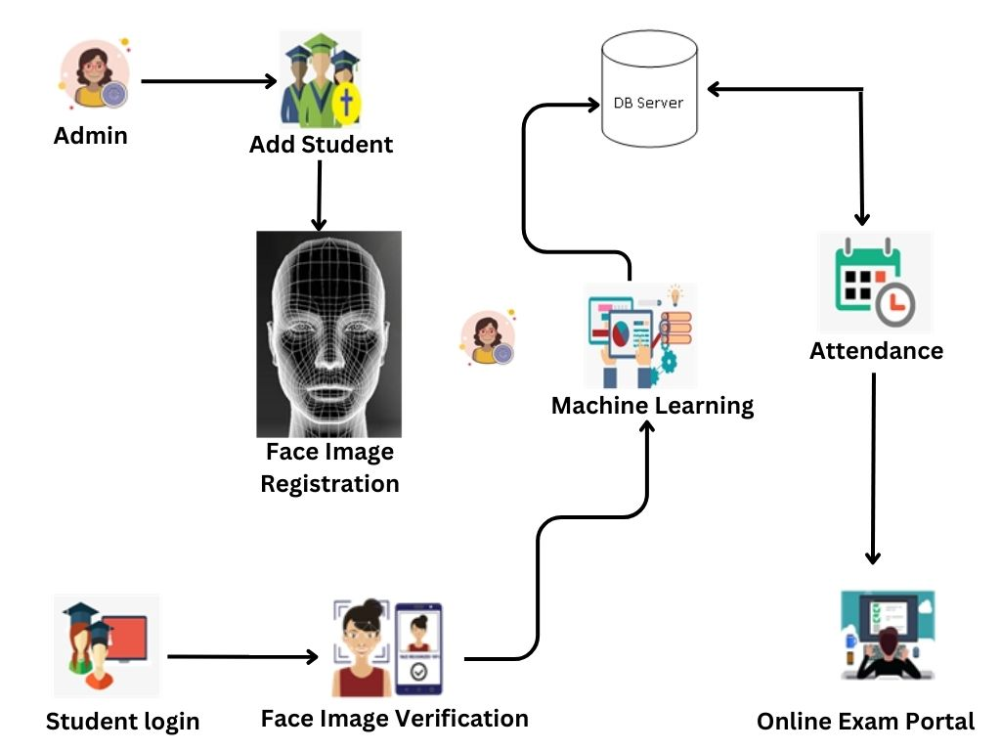
Methodology used
Methodology /working :
Computer Vision for face detection, mobile detection, background monitoring
Audio Signal Processing for whisper and dual-voice detection
Behaviral Pattern Analysis for eye tracking, head pose, body posture
Browser & System Lockdown to prevent tab switching, copy-paste, VM usage
AI-based Anomaly Detection to flag suspicious actions automatically
Ensures exam integrity
Real-time cheating detection
Accurate identity verification
Remote exam support
Automatic grading & reports

Slide 5
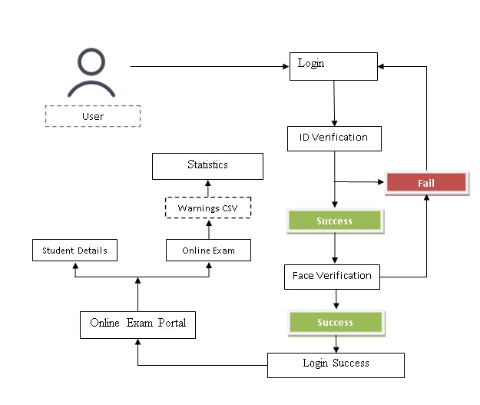
Solution Concept & Feasibility
Solution :
The concept is to create a multi-layered AI proctoring system that goes beyond basic webcam monitoring by combining visual, audio, behavioral, and system-level security.
Uses existing webcams, microphones, and browsers
No special hardware required
Platform feasible: Works on online platforms
Can be implemented for colleges, universities, and exam platforms
Scalable and cost-effective using cloud infrastructure

Slide 6
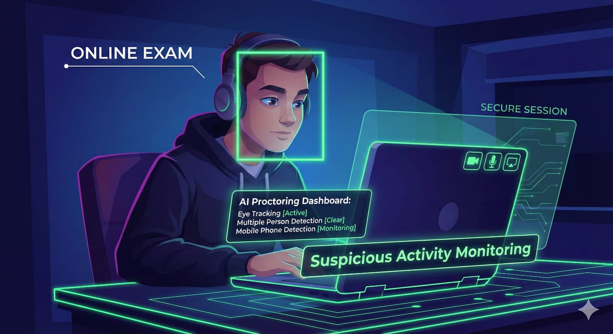
Use cases & description
Use cases :
Use Case 1: College Online Exams
Ensures fair exams during internal assessments and semester exams.
Use Case 2: Certification Platforms
Prevents impersonation and cheating in skill-based online tests.
Use Case 3: Remote Recruitment Tests
Maintains integrity during online aptitude and technical interviews.
Use Case 4: The Virtual Machine Sandox Attack: Monitoring runs in a virtual environment while cheating occurs on the host system

Slide 7
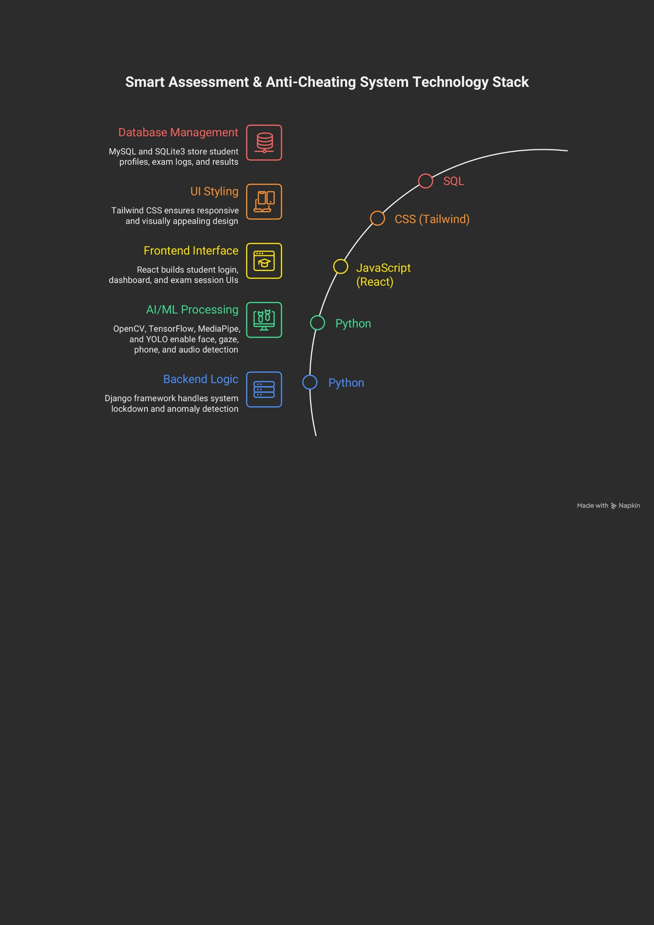
Technology stack used
Technology used :
Frontend: React , Tailwind css
Backend: Python, Django
AI & ML: OpenCV , TensorFlow , Media Pipe ,Yolo
Database: MySQL, SQLite3
Cloud: AWS
Security: Browser Lockdown APIs

Slide 8

Constraints
CHALLENGES
Network Connectivity Issues
Challenge: Unstable internet may interrupt monitoring or session flow.
Strategy: Provide auto‑reconnect and session resume support.
Limited Login Attempts
challengs: Users may face issues if login attempts are restricted.
Strategy: Allow 2–3 secure login attempts with OTP or verification.
Time‑Bound Access
Challenge: Late login or repeated refresh may cause access issues.
Strategy: Allow limited retries within a defined time window.

